Slide 1
R-noobs for Hackathon
Members:
JT Sarmento
Zhoulin Wang
Temuulen Enebish
Tingyu Yang

Slide 2
Data Visualization
Separate by Previous
Most useful predictors
Model Prediction
For Previous = 0
For Previous $≠$ 0
For Previous ≠ 0

Slide 3
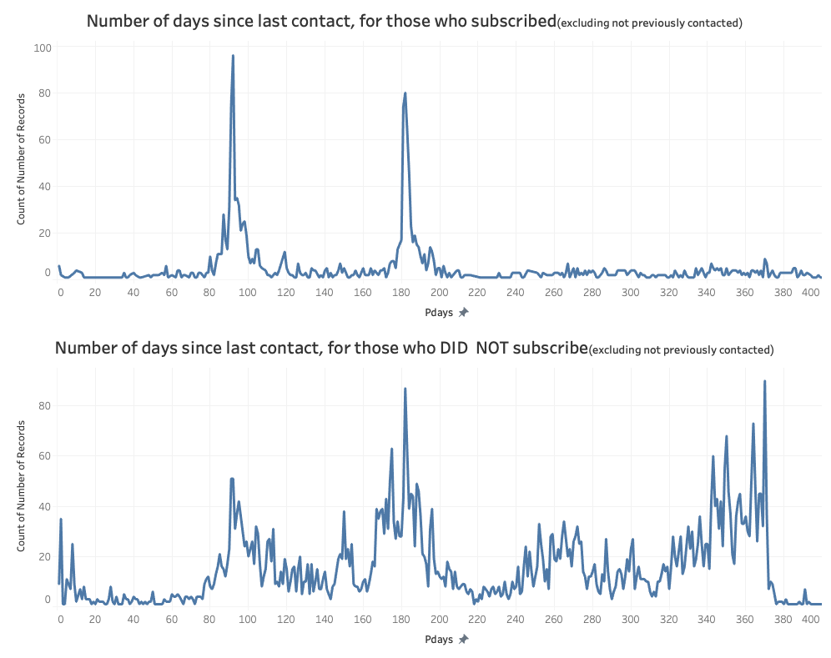
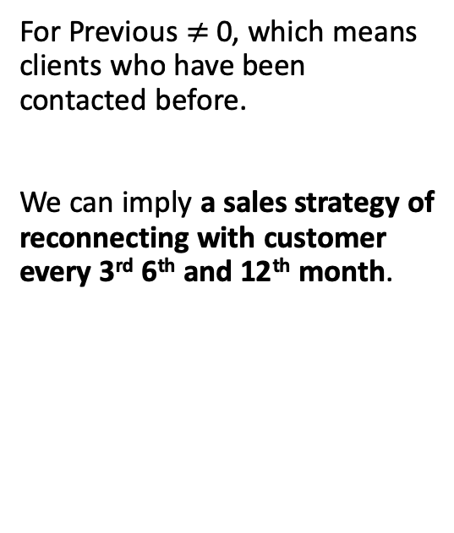
Previous Days Since Last Contact
For Previous $≠$ 0, which means clients who have been contacted before.
We can imply a sales strategy of reconnecting with customer every 3rd 6th and 12th month.
3 months
6 months
12 months
Notes:
Of people who subscribed, 51.39% had been successfully marketed to.
Of people who not subscribed, 67.46% had marketing campaign to them fail.

Slide 4
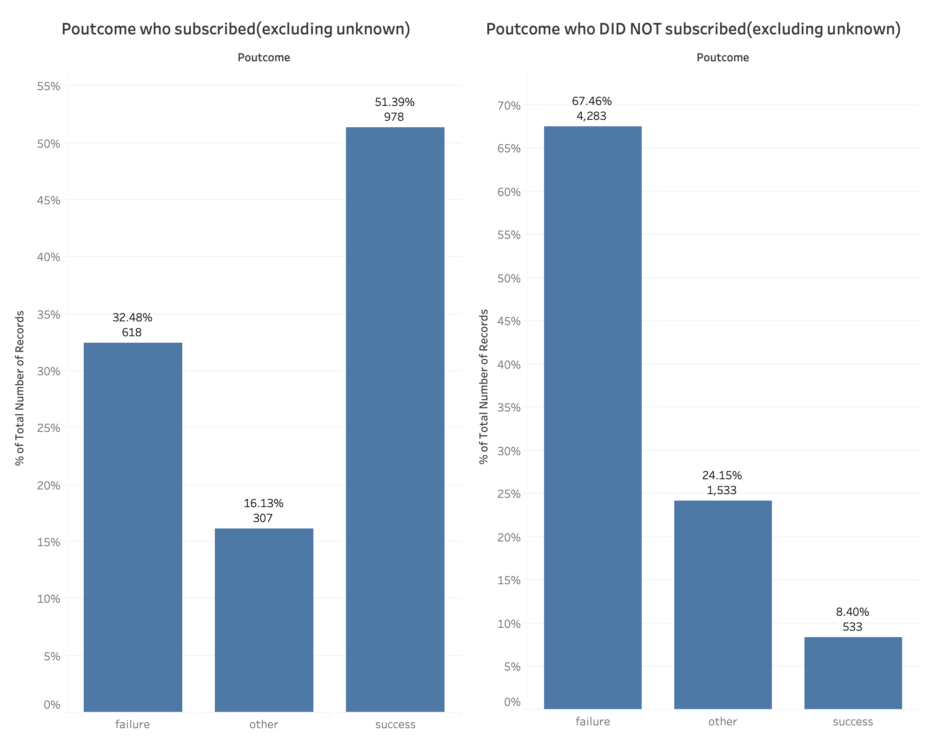
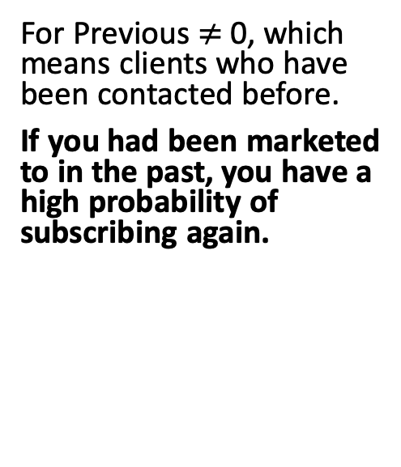
Outcome of Last Marketing Campaign
For Previous $≠$ 0, which means clients who have been contacted before.
If you had been marketed to in the past, you have a high probability of subscribing again.
Notes:
Of people who subscribed, 51.39% had been successfully marketed to.
Of people who not subscribed, 67.46% had marketing campaign to them fail.

Slide 5
Duration
Category | Quantile
1st quantile | [0, 103)
2nd quantile | [103, 180)
3rd quantile | [180, 319)
4th quantile | [319, 4918]
Of people who subscribed, majority of them spend more time during the phone call.
Of people who did not subscribe, the majority of them spend less time.

Slide 6
Predictive Modeling
Two different models
Preprocessing, model validation, hyperparameter tuning
Tidymodels framework
Model explanation
Details at: https://github.com/temuulene/r-noobs-at-ocrug

Slide 7
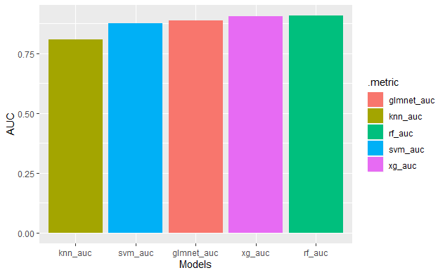

Slide 8
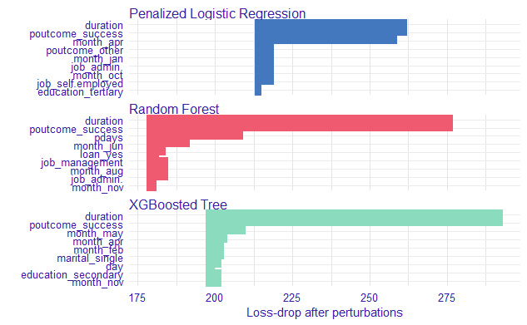

Slide 9
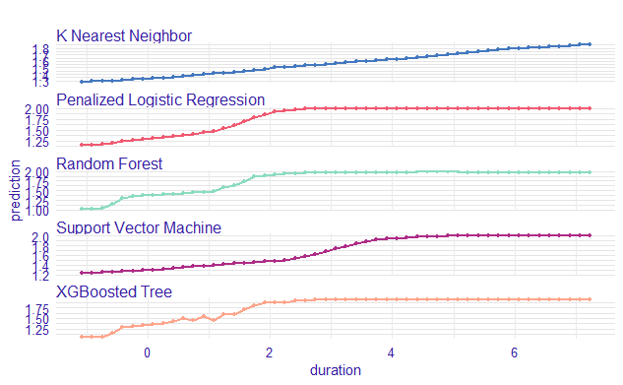

Slide 10
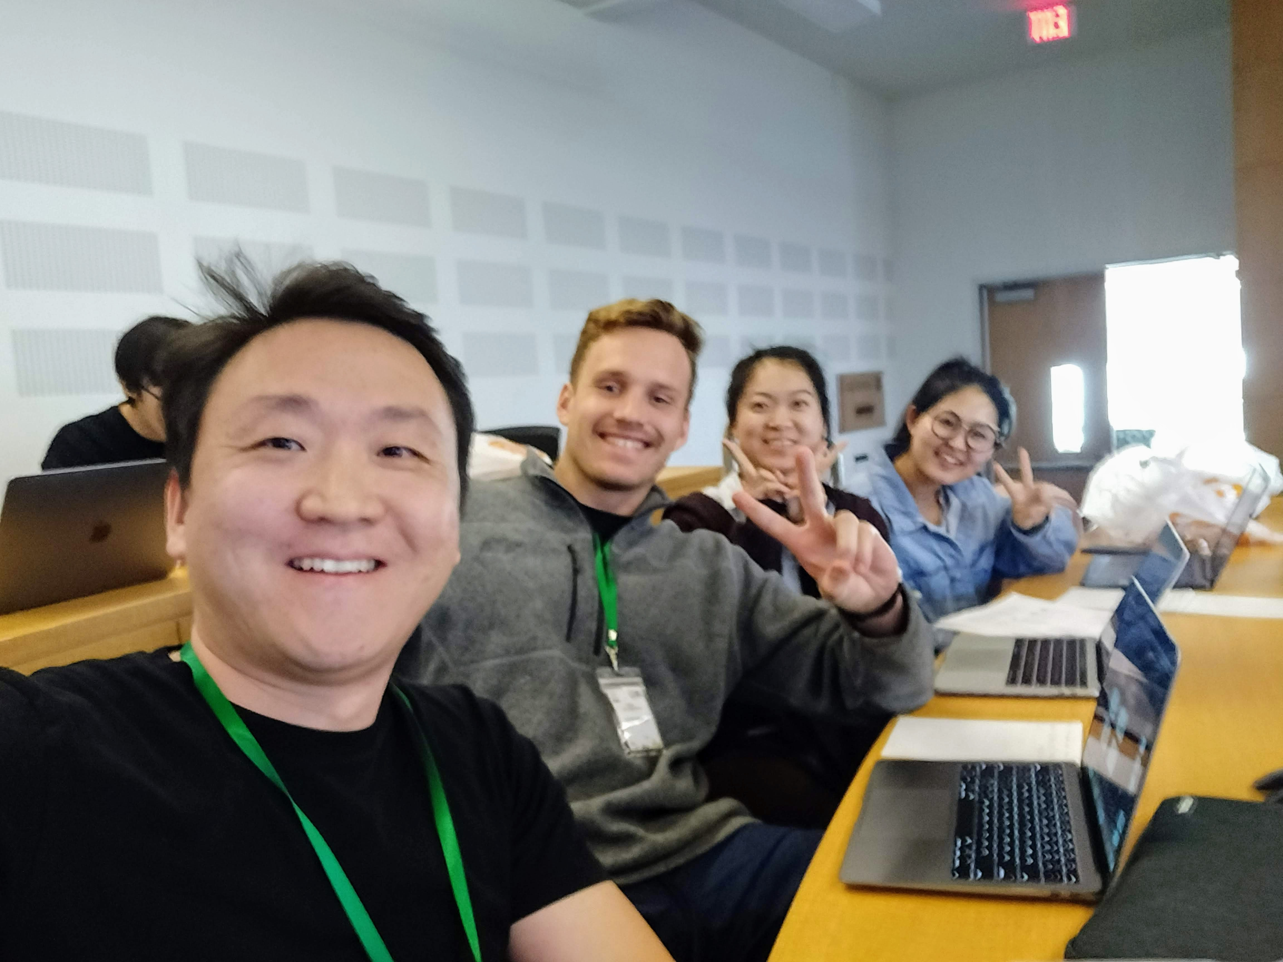
Thank you

